Slide 1
Postural Orthostatic Tachycardia Syndrome
With Dr. Santa Maria

Slide 2
What is POTS?

Slide 3
What symptoms fall under the umbrella of POTS?

Slide 4
What would be “specific” versus “nonspecific” symptoms of dysautonomia?

Slide 5
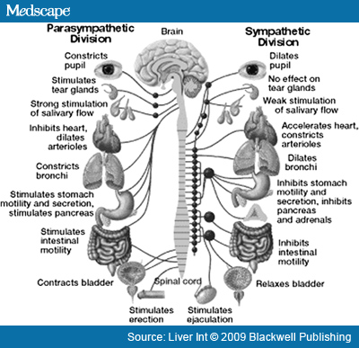
What is the autonomic nervous system and how does it work?

Slide 6
Can I be cured?

Slide 7
Can I be treated?

Slide 8
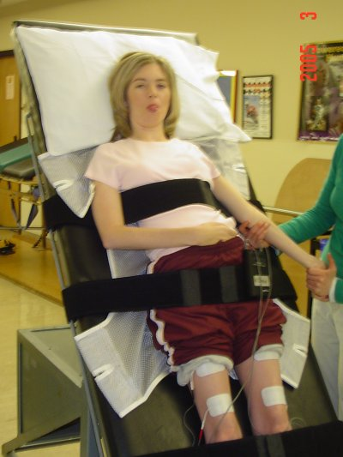
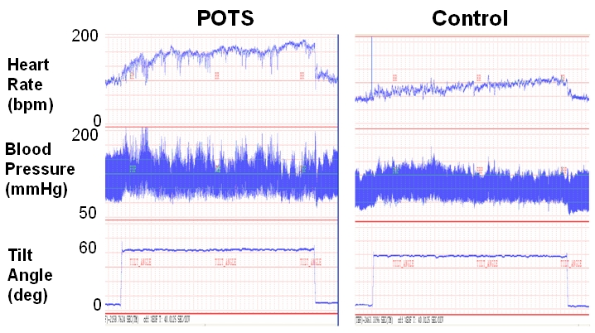
What is a Tilt Table Test?

Slide 9
What is the Val-Salva Test?

Slide 10
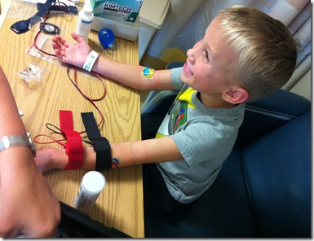
What is the sweat test?

Slide 11
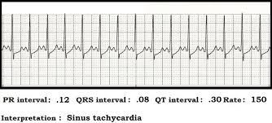
How are periods of tachycardia different from one another?

Slide 12
Is POTS a fatal illness?

Slide 13
Do all POTS patients faint?

Slide 14
Is there any treatment for POTS?

Slide 15
What medications work for POTS?

Slide 16
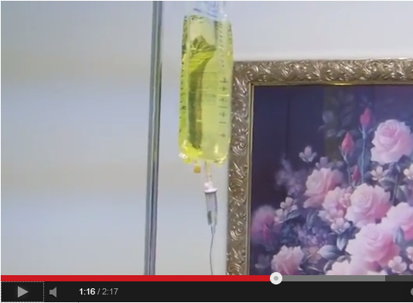
What is IV Saline Therapy? Does it work?
Demo: http://www.youtube.com/watch?v=ByRbuyiRtsE

Slide 17
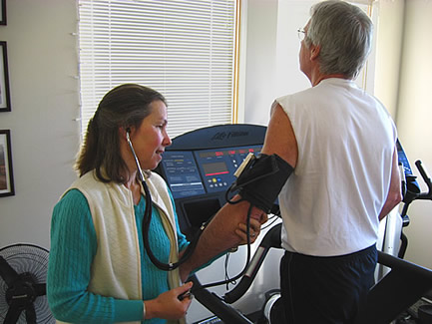
What is cardiac rehab? Would it help me?

Slide 18
What sort of diet should a POTS patient have?
High Salt
Some do best with Gluten Free Foods, but not all
Lots of hydration

Slide 19
What sort of things should a POTS patient avoid?
Direct sunlight, tanning booths, any way to become dehydrated easily
Rollercoasters, carousels, or any other machinery or rides that may cause vertigo/dizziness
Overexertion without proper cardiac rehab
Ablation of the sinus node
Alcohol
Bending up and down
Blowing up Balloons
Excessive stair climbing
Energy Drinks
Epinephrine
Doctor’s who don’t know anything about POTS
Giving Blood
Travel by Airplane
Singing and instruments
(Thanks to Dinet.org!)

Slide 20
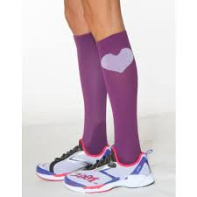
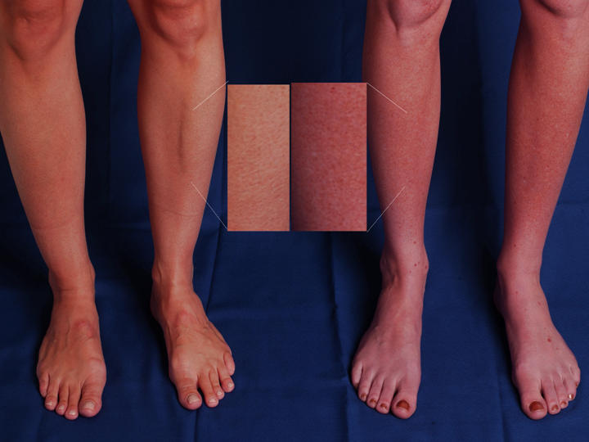
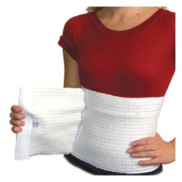
Why do compression stockings and abdominal binders work?

Slide 21
What is a POTS emergency?
Blood Pressure/Pulse out of control, erratic, or long episodes of tachycardia
Outstanding pain or discomfort
Dehydration (often leading to migraines, or other symptoms)

Slide 22
How do I explain POTS to an ER doctor?
Give them the full name of the disease “Postural Orthostatic Tachycardia Syndrome” related to “Dysautonomia” “autonomic neuropathy”
Explain your symptoms, and that you get easily dehydrated.
Explain that usually a liter of IV saline will clear up many symptoms.
Ask for other medications you feel you may need.
Give him the phone number of your regular treating physician and ask him to call.

Slide 23
What can be done at the ER to help a POTS patient?
Patients can be given
correctional beta blockers
IV saline.
pain medication
muscle relaxants

Slide 24
What do you do if a doctor won’t treat you or doesn’t “believe in” POTS?
If a doctor is not open to learning about POTS, he cannot be your doctor. You need to leave, and find another doctor.

Slide 25
What diseases are associated with POTS?

Slide 26
What is the initial presentation of POTS?

Slide 27
Where do I find a POTS doctor?
You can go through your insurance company and call the doctors, ask if they have other POTS patients
You can ask at the emergency room
You can ask around online in POTS support groups
You can search through directories at Dysautonomia websites

Slide 28
What questions should I ask a new doctor?
Do you take my insurance?
Do you know what POTS is?
Have you ever treated patients with autonomic dysfunction before?
Do you have time in your patient load to take on a patient like me?
What is your availability?
What hospitals do you work with?
Are there any other doctors on your staff that I’ll be dealing with? If so, will you inform them about my condition, in case there is an emergency?
Would you feel comfortable with me bringing in research I’ve found, and reaching out to other specialists?

Slide 29
How can students cope with POTS while in school?
-504/IEP plan,
-Bring in a one sheet
-Hospital Homebound
-Virtual school
-Have a plan—have all the staff and doctors in and on it.
-Remind school that this is a chronic illness

Slide 30
Where can we learn more about you?
Twitter Handle @DoctorBocaRaton
Email: PotsResearchProject@yahoo.com
Website: www.santamariamedicine.com
FB Group: Dysautonomia FL

