Slide 1
Advanced Questions on POTS/Dysautonomia
With Dr. Santa Maria

Slide 2
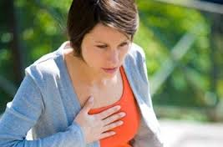
Shortness of Breath
Can you explain shortness of breath in POTS patients?
Answered here: http://santamariamedicine.com/2013/03/ask-dr-santa-maria-pots-patient-with-shortness-of-breath/
A P.O.T.S patient who is short of breath should have a doctor who is familiar with the patient’s body and past symptoms to see if there is a possible correlation.
It is critical to know the patient’s breathing history, whether or not they have asthma or a pet-related lung disease, what medications they are on, what their blood count and symptoms are that might have led to this this complaint.
They also should look to see whether the patient is cyanotic (fingertips turning blue, lips getting dusky.) If this is the case, they should immediately be forwarded to the emergency room. If they look at their palms or bend back their fingers and look at the creases and the color is red—they are probably getting enough oxygen into their system and the danger is probably not so immediate. Still—they should alert someone to keep a close eye on them, at least until the feeling subsides.

Slide 3
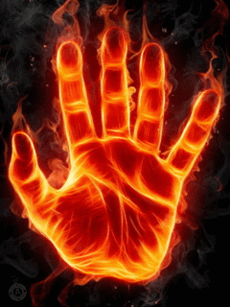
Burning Sensations/Adrenaline
Can you explain burning sensations accompanied by adrenaline rushes? Or burning in hands and feet?
Small Fiber Neuropathy
Associated with: Dysautonomia-Diabetes- Sjorgens-Lyme-Alcohol-Amyloidous (Dangerous Ducks Saluted Limited Anglophiles Awkwardly)
Treatment: IVIG/Plasmapheresis

Slide 4
Burning Sensations/Adrenaline

Slide 5
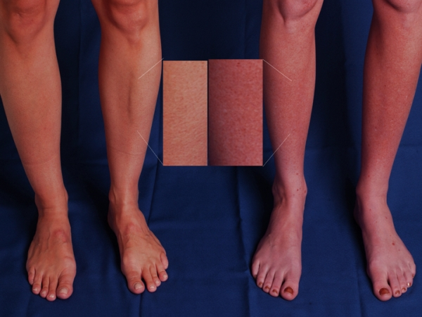
Blood Pooling
Can you explain blood pooling and what is/isn’t dangerous/normal?
NORMAL: Standing up causes about 500CC’s of blood to pool in your legs or lower body. Normal Response: Central circulation made adjustment—heart went faster, signal went out to lower vessels to tighten up. BP/Heart rate remains about the same
POTS: Central Circulation does not quickly respond to standing—The heart has to go faster to maintain the blood pressure. BP stays the same, but heart goes faster.

Slide 6
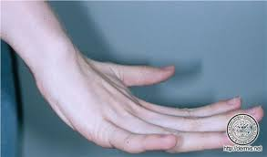
Connective Tissue Diseases and POTS?
What the connection between EDS and POTS?
Joint-hypermobility, Marphan Syndrome, EDS, Connective Tissue Structures
Association with autonomic system dysfunction—as well as Chiari syndrome—connective tissue around spinal cord may not be holding in the brain contents
One doesn’t cause the other, but there may be a common cause.
EDS Type 3 & 1 (most common) (Ten Recognized Types)
Study: Migraine was much more common in joint-hypermobility type patients—patients who have connective tissue disorder and POTs tend to become symptomatic at an earlier age. They seem to have a greater incidence of migraine and syncope than just feeling faint.

Slide 7
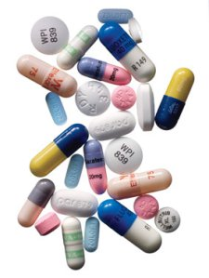
Antidepressants
What role do anti-depressants play in the treatment of dysautonomia?
SNRI & SSRI

Slide 8
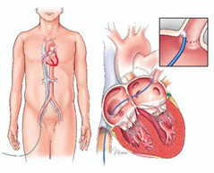
Ablations
What is an ablation? Do POTS patients need to have them?
Superventricular Tachycardias
Inappropriate Sinus Tachycardia—can be treated with ablation.

Slide 9
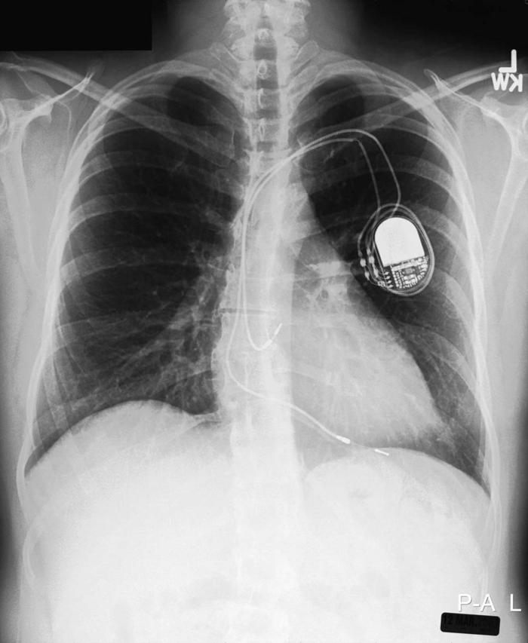
Pacemakers
Why do patients with POTS get pacemakers? What are the permanent side effects of this?
Pacemakers are put in to prevent the heart from going too slow.*
They can make the heart go fast, a demand pacemaker.

Slide 10
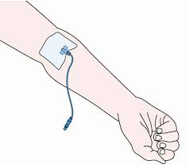
Ports/PICC Lines
Should I get a port for IV Saline therapy?
NO PICC LINES – High rate of thrombosis and infection. Meant to be temporary.
PORTS ARE GREAT (Can be low matintence and trouble free.)

Slide 11
Fluctuation of Symptoms
Patients symptoms fluctuate from day-to-day, why do I wake up some days with no energy/worse symptoms?
Menstrual cycles, circadian cycle, illness, hormone levels, state of hydration, nutritional status, environmental stress, heat, cold, rain, barometric pressure, fluctuating medication regimens.

Slide 12
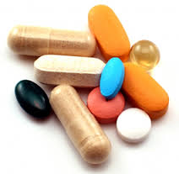
Vitamins and Supplements
What vitamins/supplements would be proactive for POTS patients to take?
B vitamins, B-12 are important, our bodies don’t generate them and are food dependent (many times in foods POTS patients can’t eat. (Gatorade does not provide vitamin B)
Vitamin C—blood vessel disorders, scurvy
Thiamin– Barri Barri Disease (Similar to Dysautonomia)

Slide 13
Studies
What’s being done at Mayo/Vanderbilt/Cleveland? Are there any studies underway for patients that might offer relief?
Check our resources page for news
Diabetes studies/ sympathetic nervous syndrome overactivity.

Slide 14
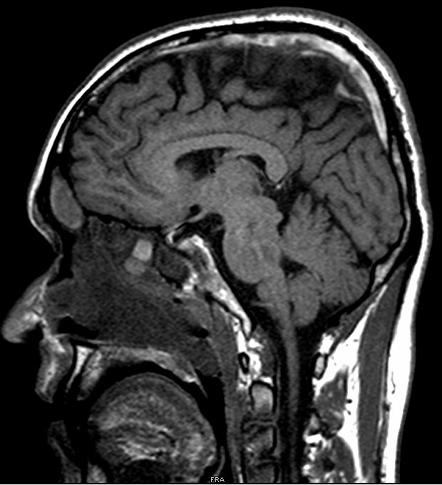
Intracranial Hypotension & POTS
Any connection between IH and POTS?
IH/Chiari/ EDS---all related diseases

Slide 15
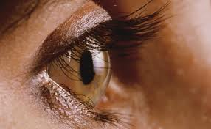
Visual Disturbances
Why do patients get floaters or visual disturbances with POTS?
Migraines
Dehydration

Slide 16
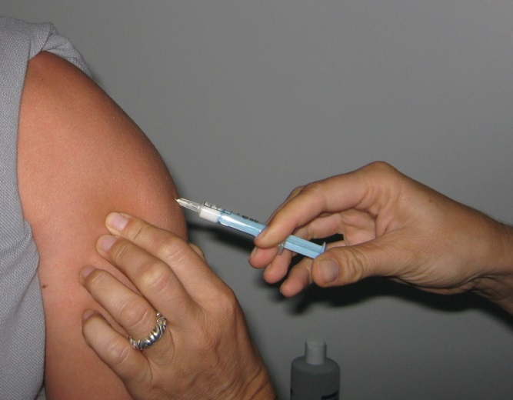
Immunizations
Should POTS patients get the flu shot, pneumonia vaccine or the Gardasil vaccine?
POTS patients should be proactive about contracting other illnesses

Slide 17
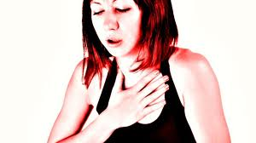
Heart Attacks
Can POTS lead to a heart attack?
Long-term—there may be structural changes to heart valves, may increase risk for heart disease.
Intrinsic versus extrinsic heart disease
IST – not currently classified as a heart disease

Slide 18
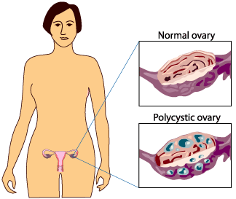
PCOS & POTS?
Any connection between PCOS and POTS?
State of insulin resistance
Pots/Diabetes

Slide 19
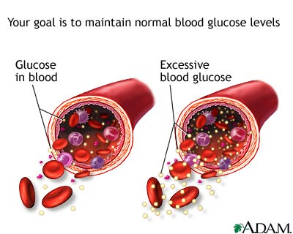
Blood Sugar Levels & POTS?
Connection between blood sugar and POTS?
Studies are being conducted on the topic—see website for documentation

